Slide 1
Web Application Development With Java CEJV 559
Week 02
Maven

Slide 2
Build Systems
All build systems are essentially the same
All IDEs have their own internal & incompatible with each other system
They all address:
Compile Source Code
Manage dependencies
Copy Resources
Compile and Run Tests
Package Project
Deploy Project
Cleanup

Slide 3
Maven Build System
Takes care of ensuring that the right library jars are in the build path of a project
Manages the compiling/building of source code
Encourages the use of unit testing by including the execution of tests when building a program
Provides a standard project file structure so that projects can be used in different IDEs

Slide 4
Maven Architecture
Plugin e.g. jar
Projects to build
Maven Core
Plugin
e.g. surefire
Plugin e.g. release
Local machine
Remote repository or local install

Slide 5
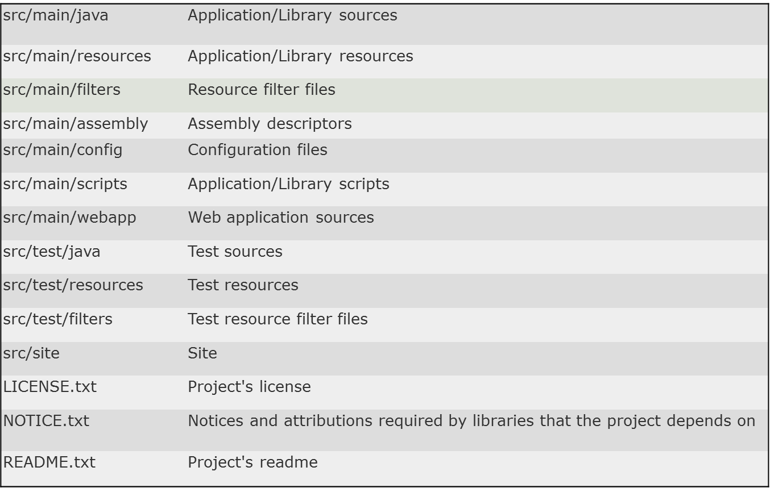
Standard Project Directory Layout

Slide 6
Maven Coordinates
All projects are uniquely identified by a set of Maven Coordinates
Group ID
Artifact ID
Version
Examples (group-id:artifact-id:version):
junit:junit:4.11
org.kuali.rice:core-api:2.2.1
edu.iu.es.esi:casfilter:1.12

Slide 7
Build Lifecycle
Three build lifecycles
default – handles building and deploying project
clean – handles project cleaning
site – handles generation of project documentation
Build lifecycles are broken down into build phases
Build phases are made up of goals

Slide 8
Build Phases for Default Lifecycle
check pom.xml
compile the source
run unit tests
create jar/war/...
verify the package
publish package to local repo
publish package to remote repo
validate
compile
test
package
verify
install
deploy

Slide 9
Plugins
Plugins are artifacts that provide goals to Maven
There is a large library of plugins out there which do all sorts of different things
You can also write your own!
Plugins are then bound to different lifecycle phases.
Either through configuration in the plugin itself
Or through manual configuration in your POM

Slide 10
Repositories
Holds build artifacts of various types
Can be local or remote
Local repository acts as a cache
Remote repositories include Maven Central or any number of other repositories that are available

Slide 11
Snapshot Builds
Snapshot builds are used to designate a version of a project which has not yet been released
The version number will end with “-SNAPSHOT”
Stored in separate repositories or in local repository
Are never synchronized to Maven Central
Can be updated after deployed, unlike release artifacts which are “frozen” once released.

Slide 12
Maven POM
Stands for Project Object Model
Describes a project
Name and Version
Artifact Type
Source Code Locations
Dependencies
Plugins
Profiles (Alternate build configurations)
Uses XML

Slide 13
Project Name (GAV)
Maven uniquely identifies a project using:
groupID: Arbitrary project grouping identifier
Based on Java package
artfiactId: Arbitrary name of project
version: Version of project
Format {Major}.{Minor}.{Maintenance}
Add ‘-SNAPSHOT ‘ to identify in development
GAV Syntax: groupId:artifactId:version
<?xml version="1.0" encoding="UTF-8"?>
<project>
<modelVersion>4.0.0</modelVersion>
<groupId>org.cejv456.training</groupId>
<artifactId>maven-training</artifactId>
<version>1.0</version>
</project>

Slide 14
Maven Repository
Local repository
External repositories
user local
internal
external
Maven
Central (default)
User workstation
Local network
Internet

Slide 15
Maven Repositories
Dependencies are downloaded from repositories via http
Downloaded dependencies are cached in a local repository
Usually found in ${user.home}/.m2/repository
Repository follows a simple directory structure
{groupId}/{artifactId}/{version}/{artifactId}-{version}.jar
groupId ‘.’ is replaced with ‘/’
Maven Central is primary community repo
http://repo1.maven.org/maven2
The Central Repository can be searched at:
http://search.maven.org/#browse

Slide 16
Bibliography
Maven Homepage
http://maven.apache.org
Reference Documentation for Maven
Reference Documentation for core Plugins
Sonatype Resources
http://www.sonatype.com/resource-center.html
Free Books
Videos
Article on the pom.xml file
http://www.omniprogrammer.com/?p=456

